Slide 1
Analysis of Medical Data: Correlations and Risk Factors
Kalyan pothineni
Dsc530 – Final Term project

Slide 2

Introduction:
Welcome to my presentation on the "Analysis of Medical Data: Correlations and Risk Factors."
In the realm of healthcare, understanding the relationship between medical indicators and potential health risks is paramount.
This presentation delves into an exploratory analysis of a dataset containing various medical indicators, aiming to uncover correlations and identify factors associated with cardiovascular health risks.

Slide 3

Hypothesis:
Hypothesis: "Certain medical indicators are correlated with the risk of cardiovascular issues."
Justification:
In the realm of medical research, identifying risk factors associated with cardiovascular health is of utmost importance.
By analyzing a range of medical indicators, we can gain insights into potential correlations and significant predictors of cardiovascular issues.
This understanding could have significant implications for early detection, prevention, and targeted intervention strategies, ultimately improving patient outcomes.

Slide 4
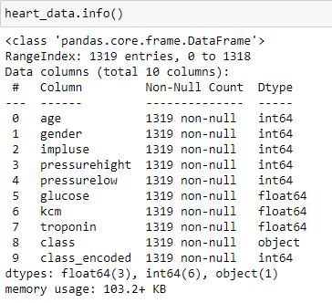
Dataset Overview:
Our analysis is based on a dataset that contains key medical indicators and health class labels, offering a valuable glimpse into the factors that contribute to cardiovascular health.
Let's explore the main attributes of this dataset.
Dataset Columns
"age": Age of the individual.
"gender": Gender of the individual (1 for male, 0 for female).
"impluse": Pulse rate.
"pressurehight": High blood pressure reading.
"pressurelow": Low blood pressure reading.
"glucose": Blood glucose level.
"kcm": Potassium concentration in blood.
"troponin": Troponin concentration in blood.
"class": Health class ("positive" or "negative" for cardiovascular risk).

Slide 5
Variables:
Age:
Type: Numerical Variable
Description: Age is a continuous numerical variable representing the chronological years of an individual at the time of data collection. It holds real-valued data points within a certain range.
Impluse (Pulse Rate):
Type: Numerical Variable
Description: Pulse rate is a continuous numerical variable measured in beats per minute (bpm). It represents the heart rate and can take various real-number values within a specific range.
Pressure High:
Type: Numerical Variable
Description: High blood pressure (systolic pressure) is a continuous numerical variable. It quantifies the force exerted against arterial walls when the heart contracts. It involves real-valued measurements.

Slide 6
Variables: (Cont.…)
Glucose:
Type: Numerical Variable
Description: Blood glucose level is a continuous numerical variable measured in milligrams per deciliter (mg/dL). It quantifies the concentration of glucose in the bloodstream with real-number values.
KCM (Potassium Concentration in Blood):
Type: Numerical Variable
Description: Potassium concentration in the blood is a continuous numerical variable measured in millimoles per liter (mmol/L). It represents the electrolyte's concentration with real-valued measurements.
By categorizing these variables, we can better understand their nature and potential use in analytical techniques. Numerical variables provide quantitative information that can be utilized in various statistical analyses to uncover relationships, trends, and patterns related to cardiovascular health.

Slide 7
Histograms:
Histograms are a valuable tool in exploratory data analysis as they allow us to make initial inferences, guide further analysis, and identify areas that may require deeper investigation.
By visualizing the distribution of variables, we gain a better understanding of the underlying characteristics of the data and can tailor subsequent analyses accordingly

Slide 8
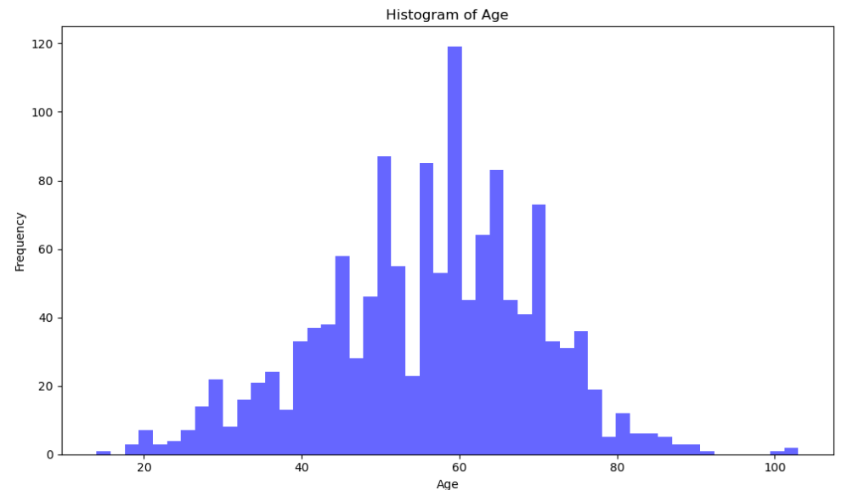
Age:

Slide 9
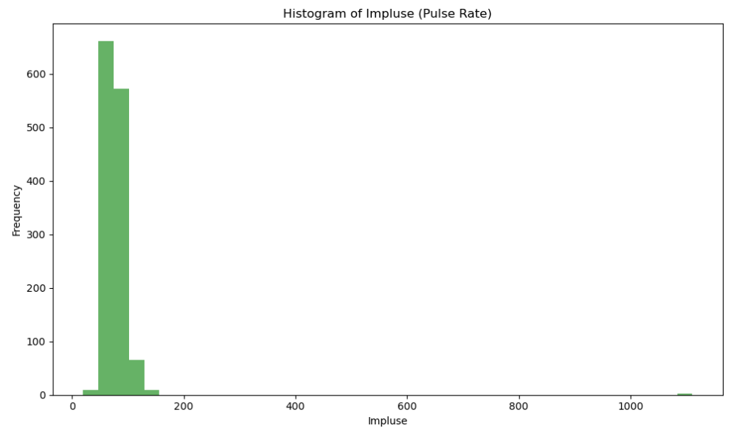
Impluse:

Slide 10
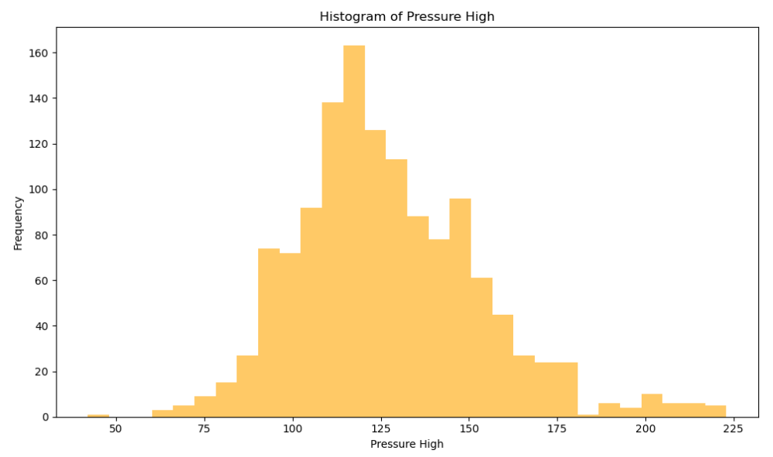
Pressure High:

Slide 11
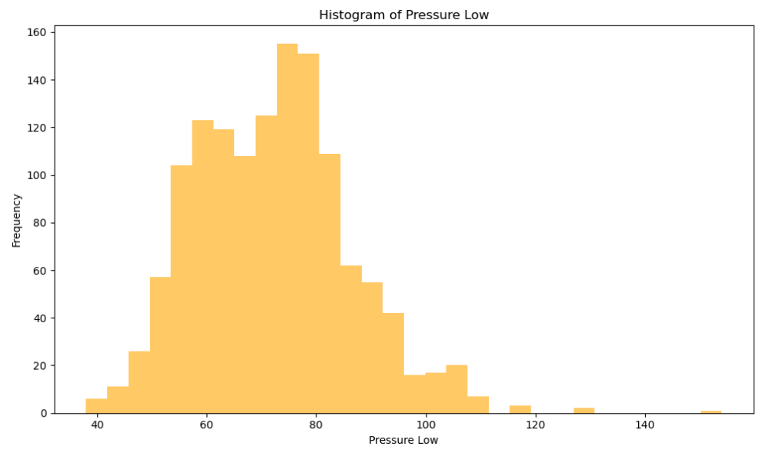
Pressure Low:

Slide 12
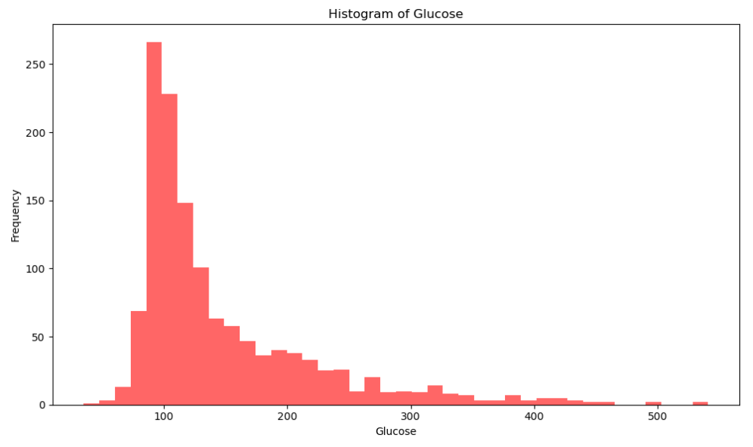
Glucose:

Slide 13
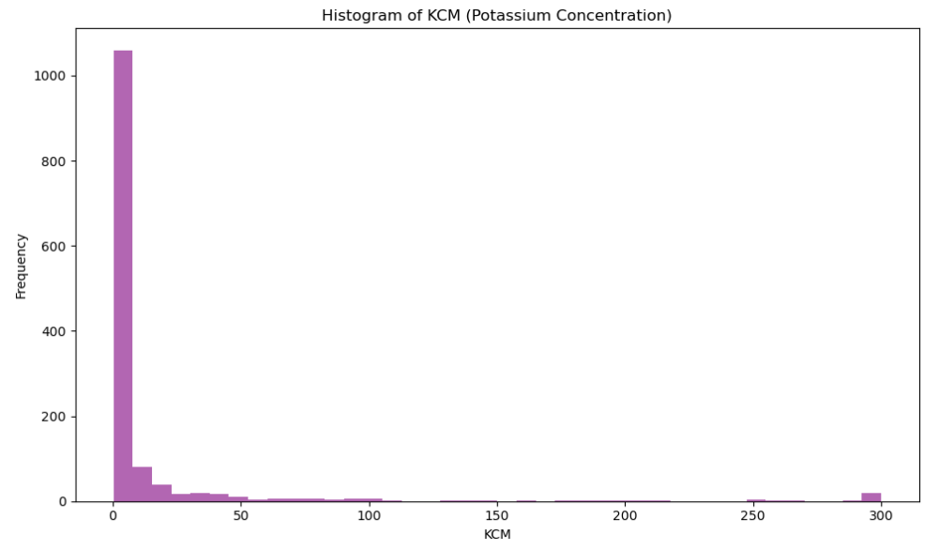
KCM(Potassium Concentration in Blood):

Slide 14
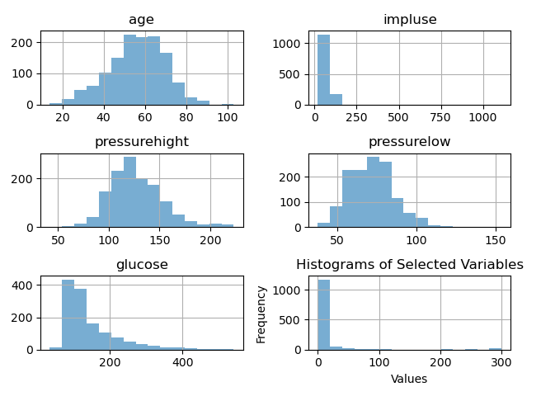
Consolidated:

Slide 15
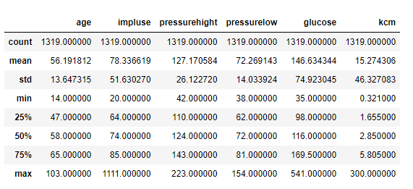
Descriptive Statistics:

Slide 16
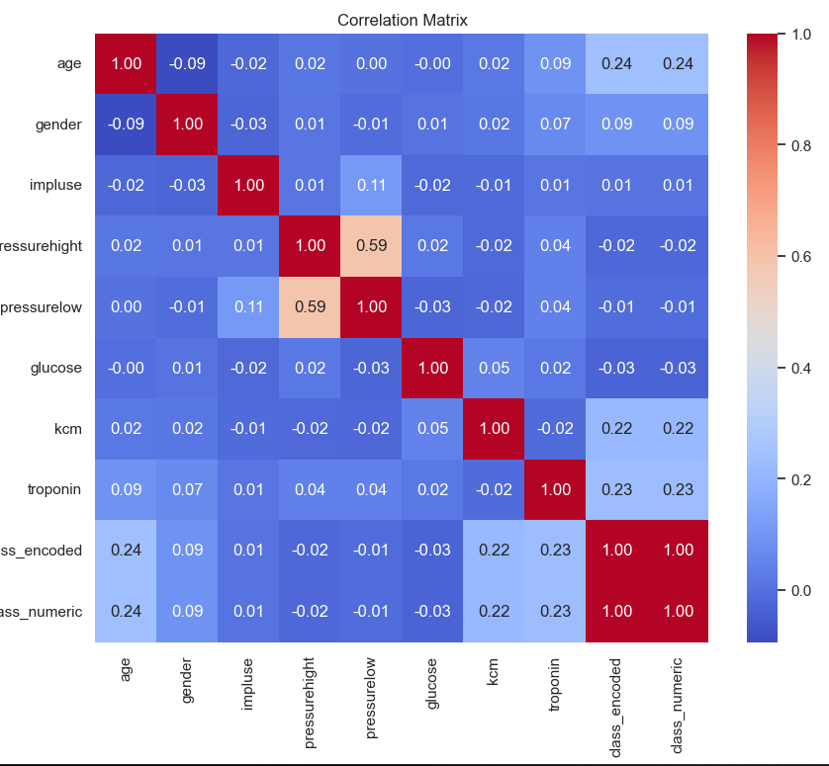
Corelation Matrix

Slide 17
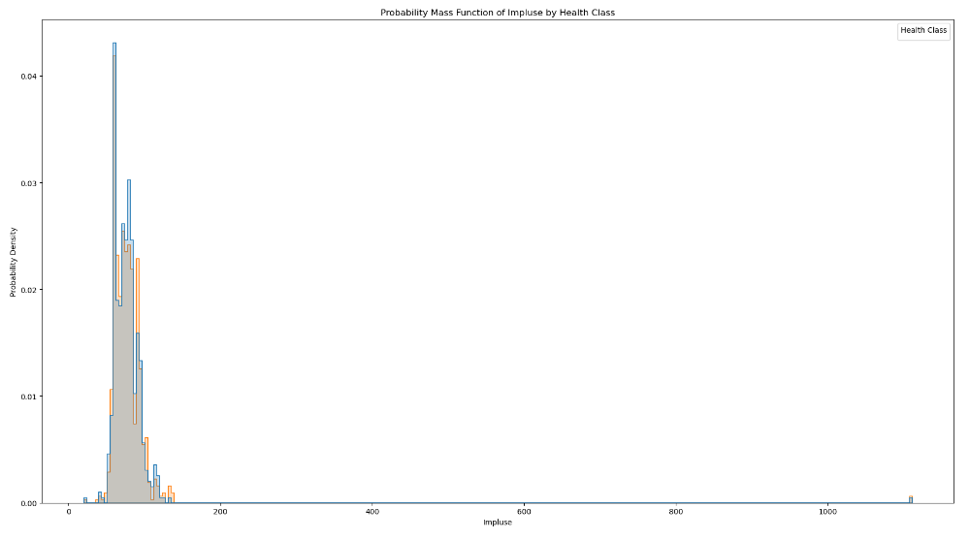
Probability Mass Function (PMF):
PMF of the 'impluse' variable based on health class provides a means to examine how pulse rates are distributed among different health classifications. This comparison adds depth to our analysis by highlighting the potential distinctions in pulse rate distribution for individuals in varying cardiovascular risk categories

Slide 18
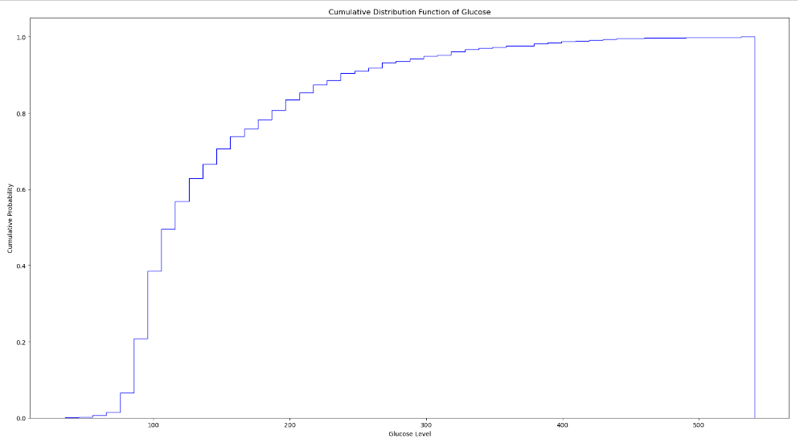
Cumulative Distribution Function (CDF):
CDF of the 'glucose' variable provides a clear picture of the distribution of glucose levels, aiding our exploration of potential cardiovascular risk factors. It complements our analysis by offering a broader perspective on the prevalence of different glucose levels and their implications in the context of the research question

Slide 19
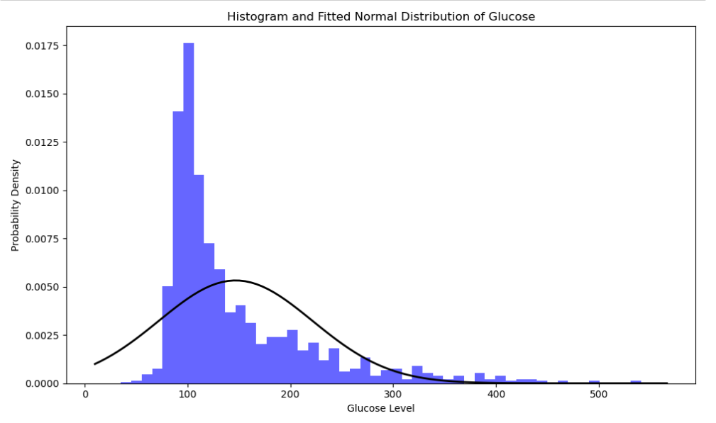
Analytical Distribution:
The analytical distribution plot provides an insightful comparison between the empirical 'glucose' distribution and a theoretical normal distribution. It aids in assessing the distribution's fit, which is valuable for applying statistical methods and making informed decisions based on the dataset

Slide 20
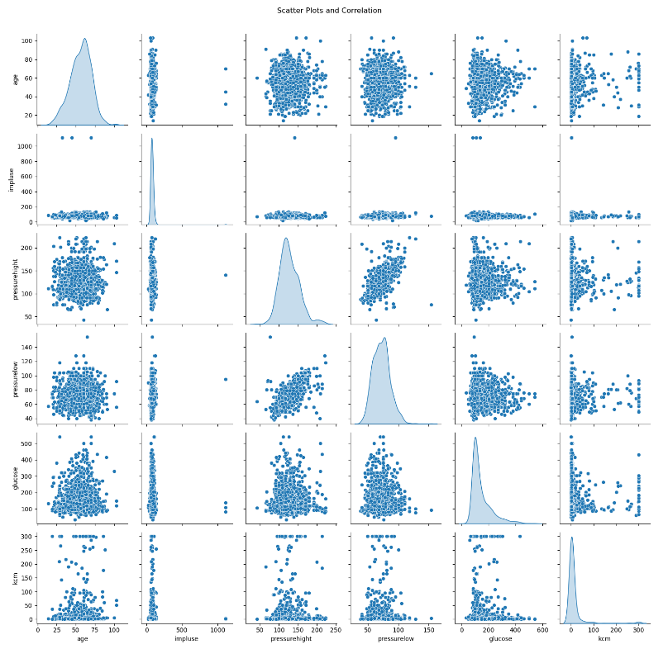
Scatter Plots and Correlation:

Slide 21
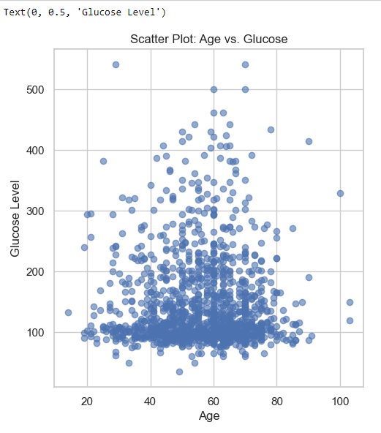
Scatter Plot comparing Age and Glucose:

Slide 22
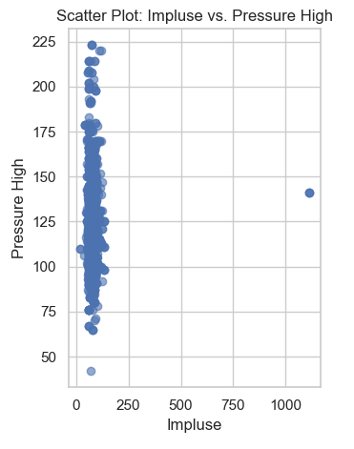
Scatter Plot comparing Impluse and Pressure High:

Slide 23
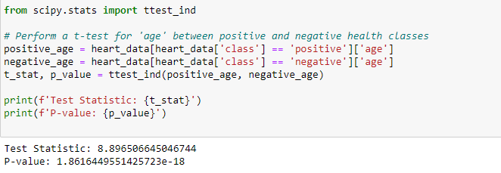
Hypothesis Test:

Slide 24
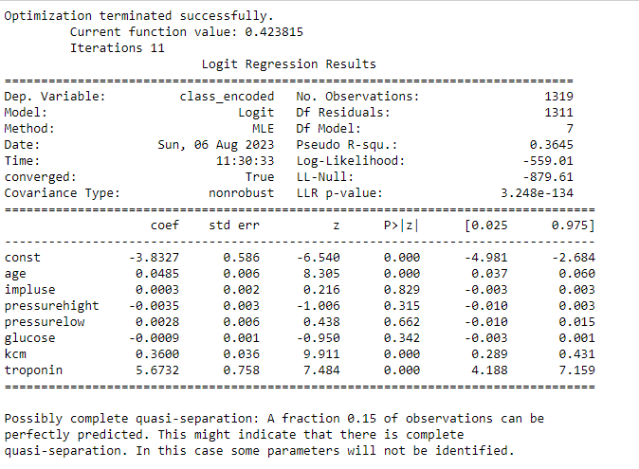
Regression Analysis:

Slide 25
Conclusion:
In our logistic regression analysis, we explored the relationship between various medical indicators and the health class, which signifies cardiovascular risk. Here's a summary of our findings:
Age: Age displayed a significant positive association with cardiovascular risk. Each year increase in age was associated with a 4.85% higher odds of being in the positive health class, indicating a higher risk.
Impluse (Pulse Rate): Pulse rate did not demonstrate a statistically significant relationship with cardiovascular risk. Its coefficient was small and not statistically significant.
Pressure High: High blood pressure readings showed no significant relationship with cardiovascular risk. The coefficient was not statistically significant, suggesting that this variable may not be a strong predictor in this model.
Pressure Low: Similarly, low blood pressure readings did not show a statistically significant relationship with cardiovascular risk.

Slide 26
…
Glucose: Blood glucose levels also did not demonstrate a significant association with cardiovascular risk.
KCM (Potassium Concentration in Blood): Higher potassium concentration exhibited a strong positive relationship with cardiovascular risk. An increase in potassium concentration was associated with a 360% higher odds of being in the positive health class.
Troponin: Troponin concentration displayed the most substantial positive relationship with cardiovascular risk. Higher troponin levels were associated with a remarkable 567.32% higher odds of being in the positive health class.
Our logistic regression model, while providing valuable insights, also exhibited some limitations due to quasi-separation, suggesting that certain observations can be perfectly predicted. Despite this, our analysis underscores the significance of age, potassium concentration, and troponin levels as potential indicators of cardiovascular risk. Further research is necessary to delve deeper into these relationships and explore potential interventions for better cardiovascular health outcomes.

